Slide 1


Opensource firewall assignment ca1
JAMES FINGLAS B00094138@STUDENT.ITB.IE
CATHAL MURPHY B00095643@STUDENT.ITB.IE

Slide 2
Contents:
RECON SCANS & MITIGATIONS
SERVICE ATTACKS & MITGATIONS
PROXY BYPASSES OF MITIGATION & FURTHER MITIGATION
COMPARISON AND CONCLUSIONS

Slide 3
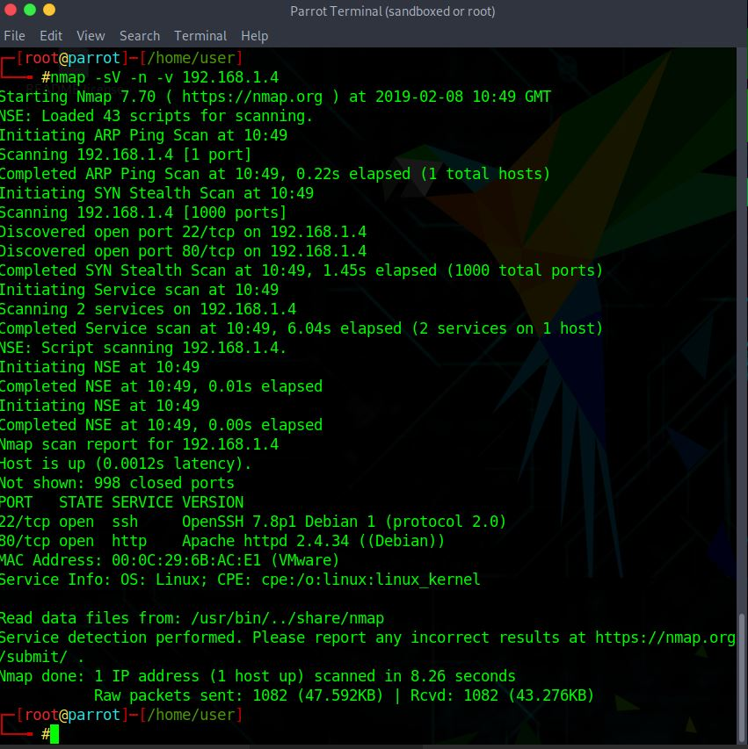
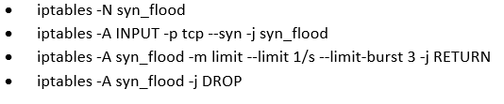
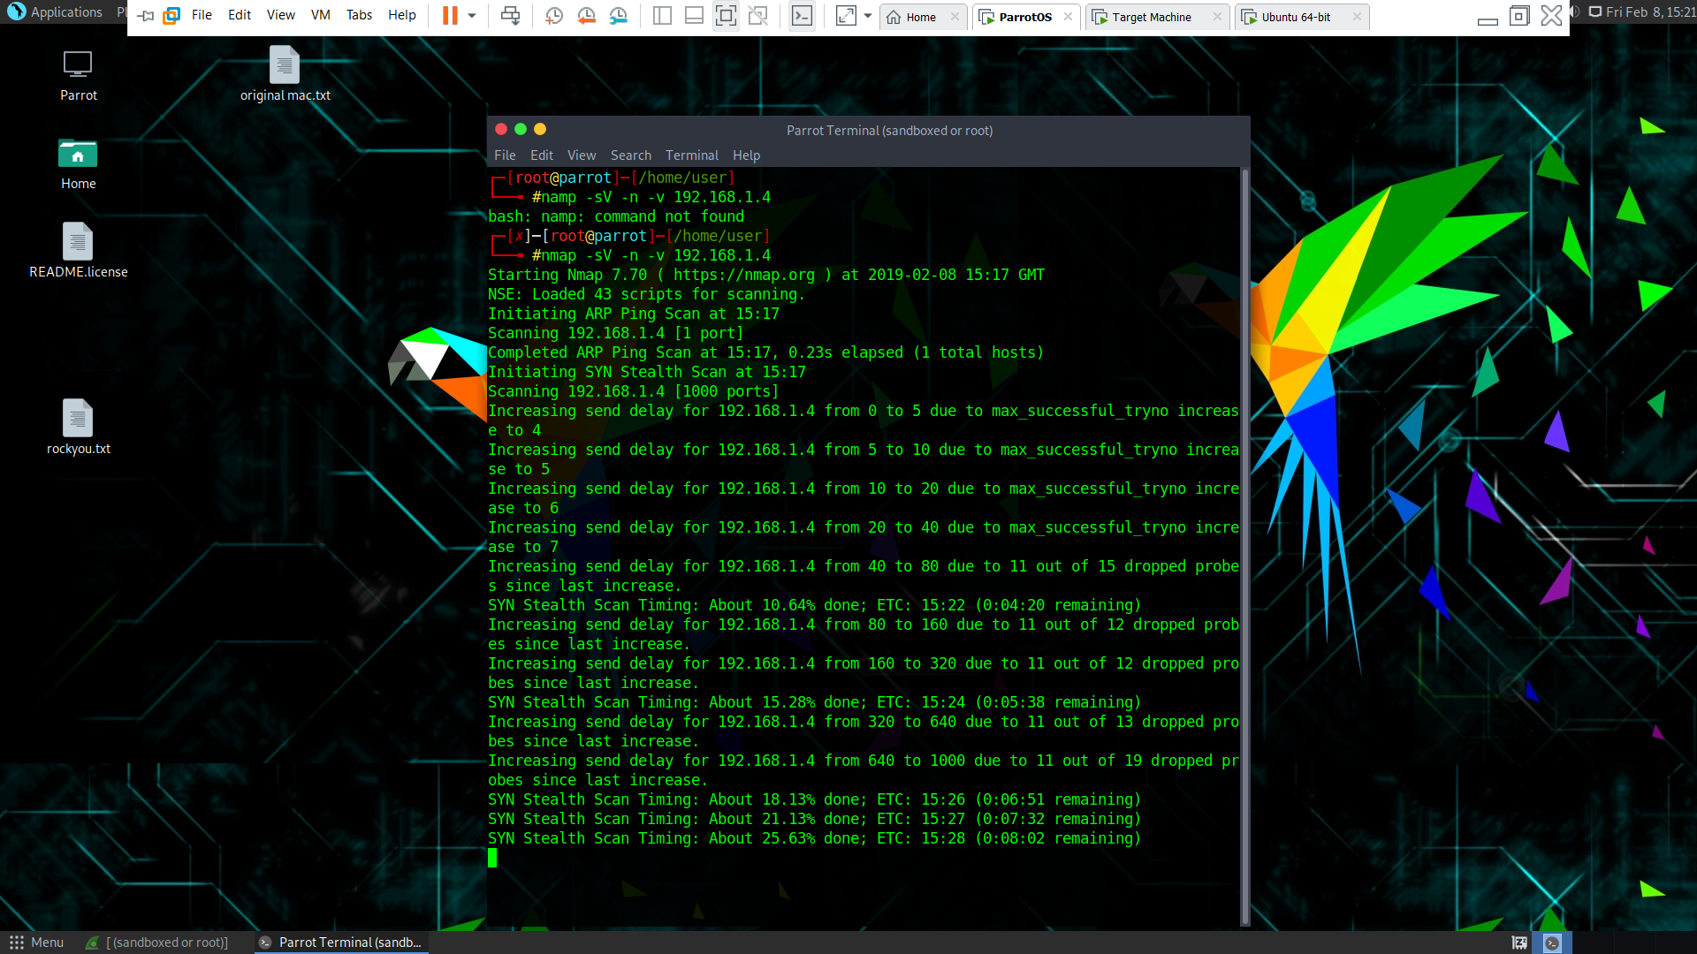
1.RECON SCAN & MITIGATIONS iptables

Slide 4
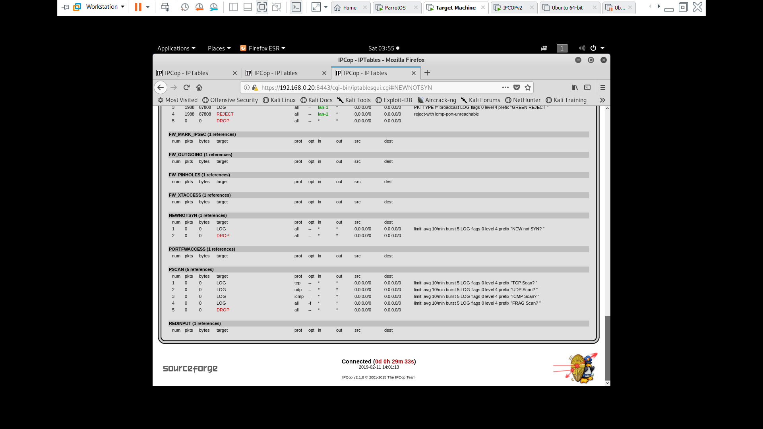
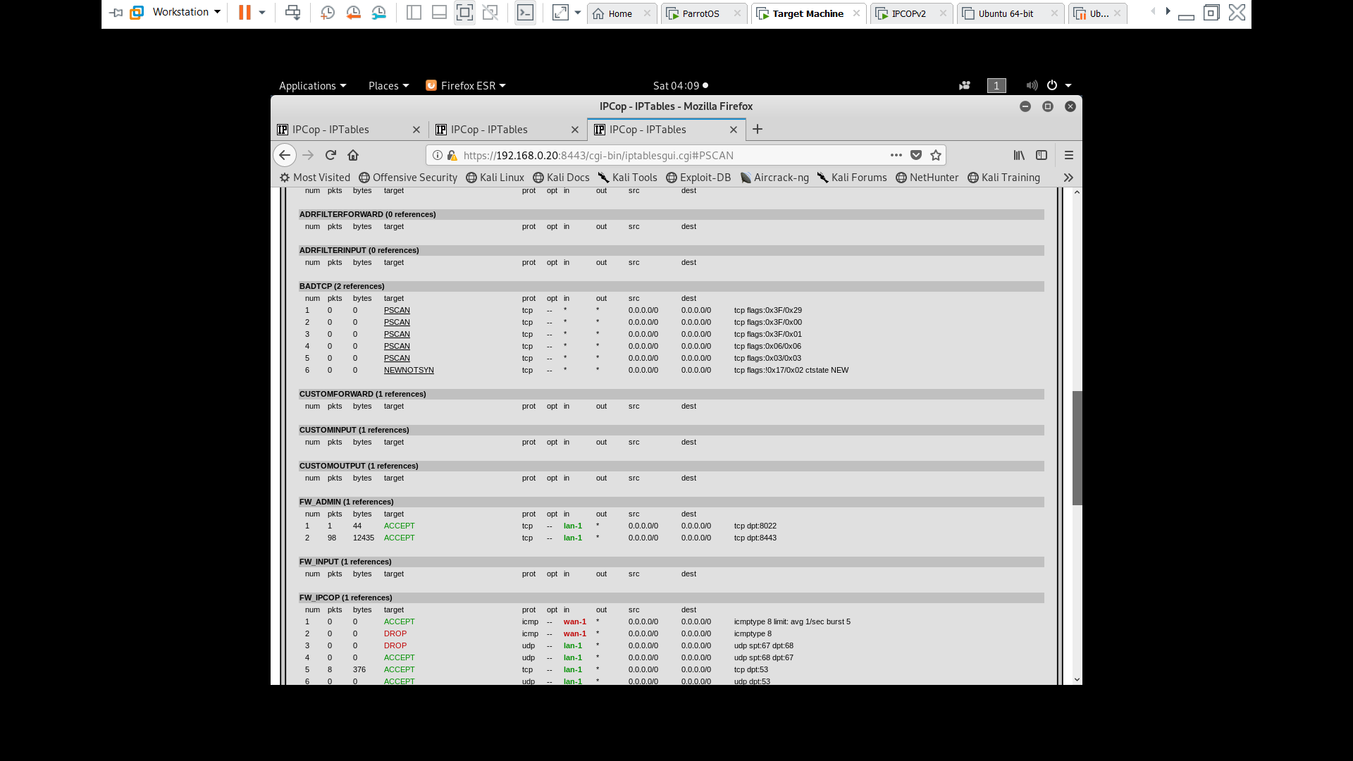
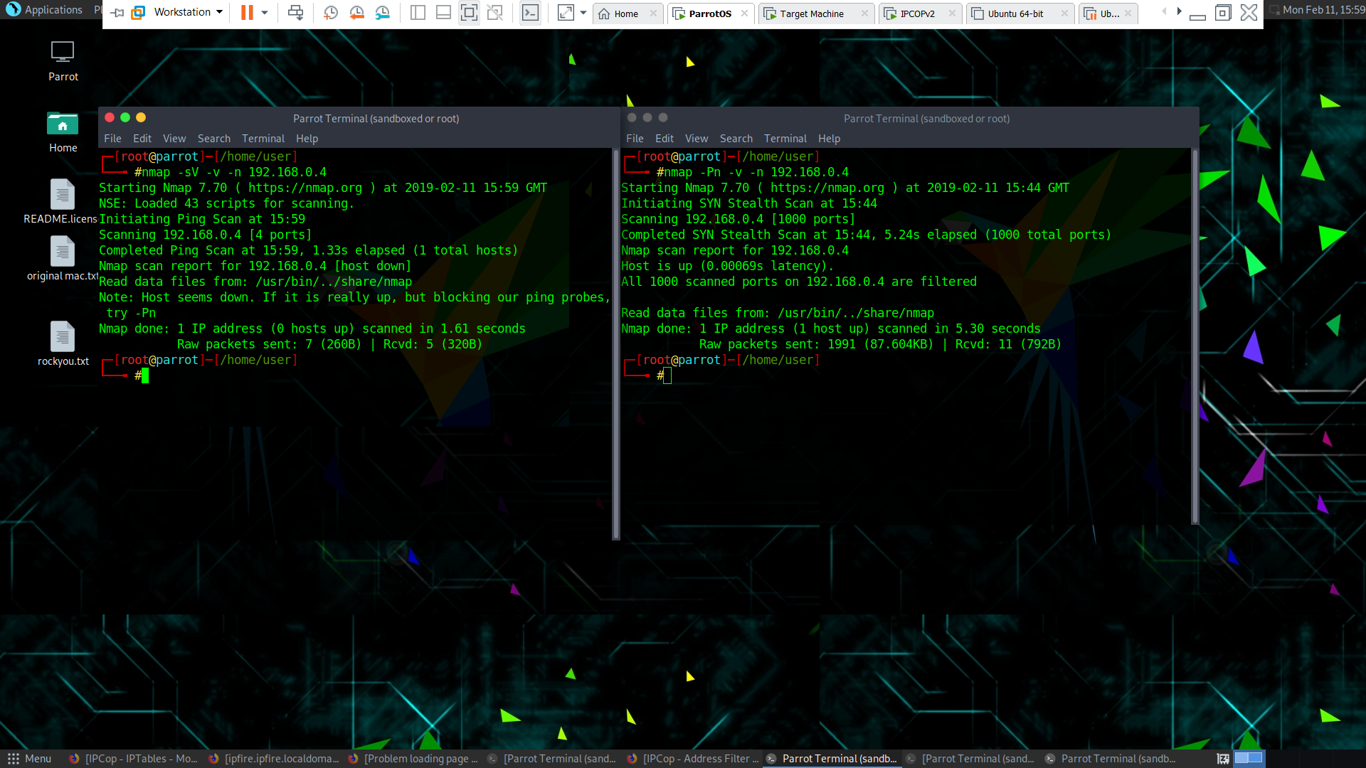
1.RECON SCAN & MITIGATIONS ipCop
Nmap Results on IPCop

Slide 5
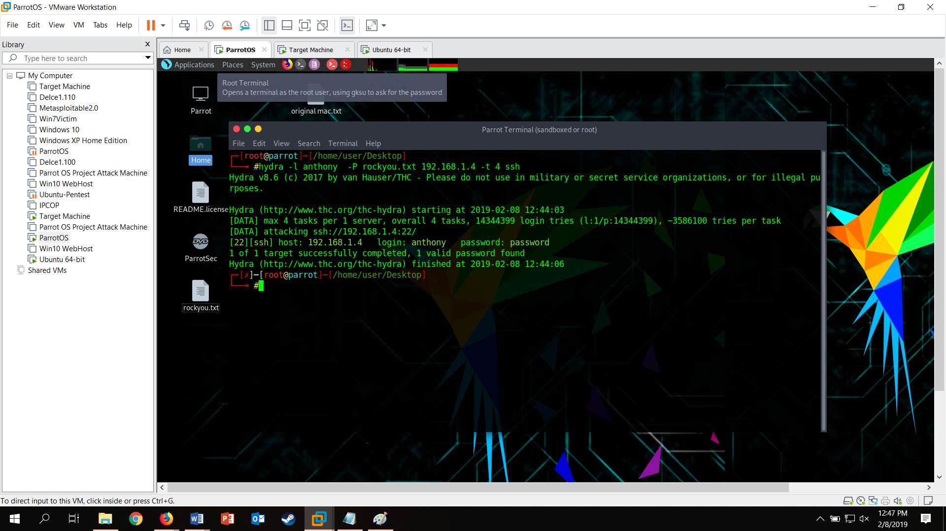
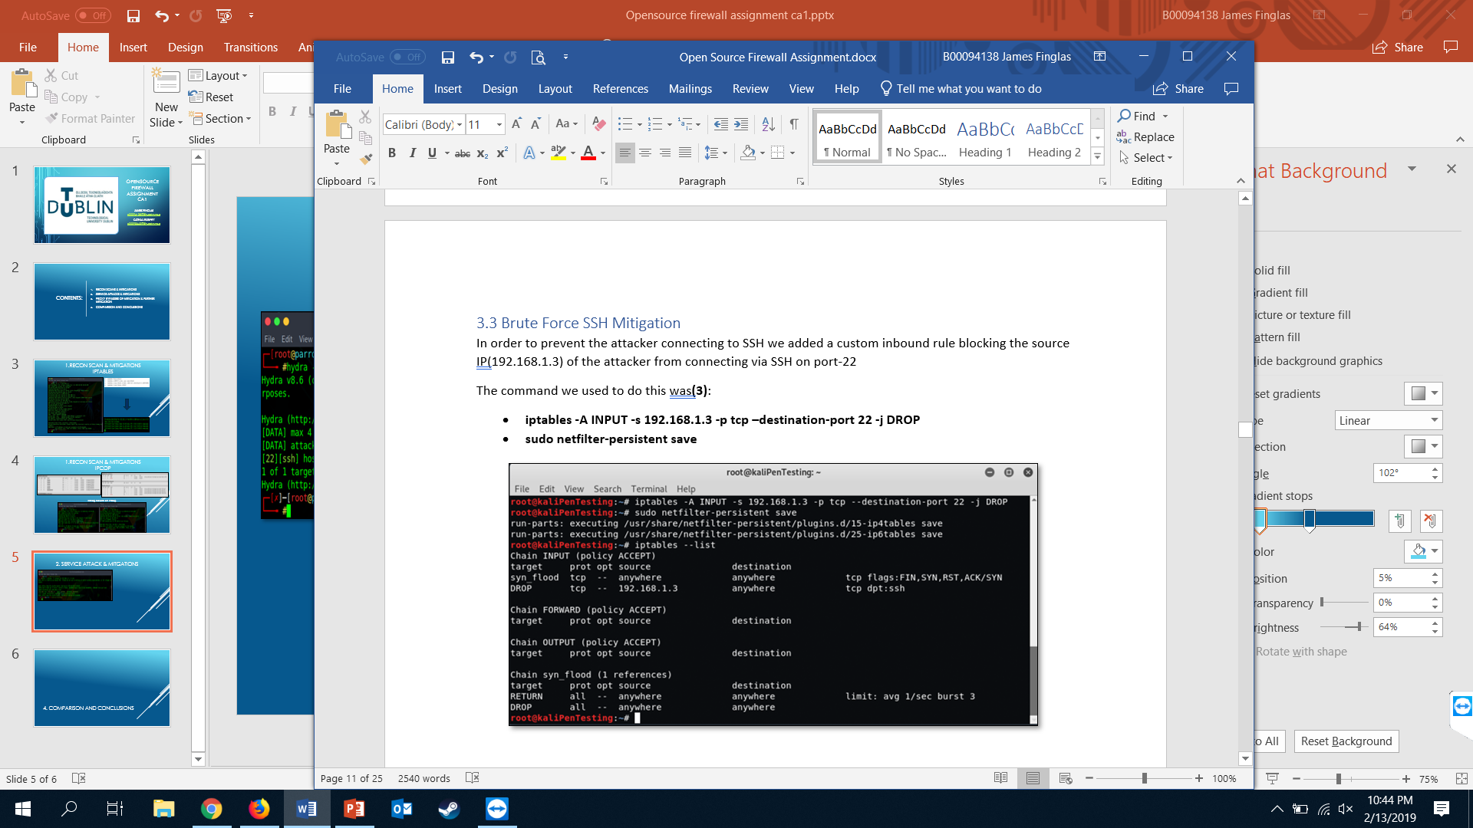
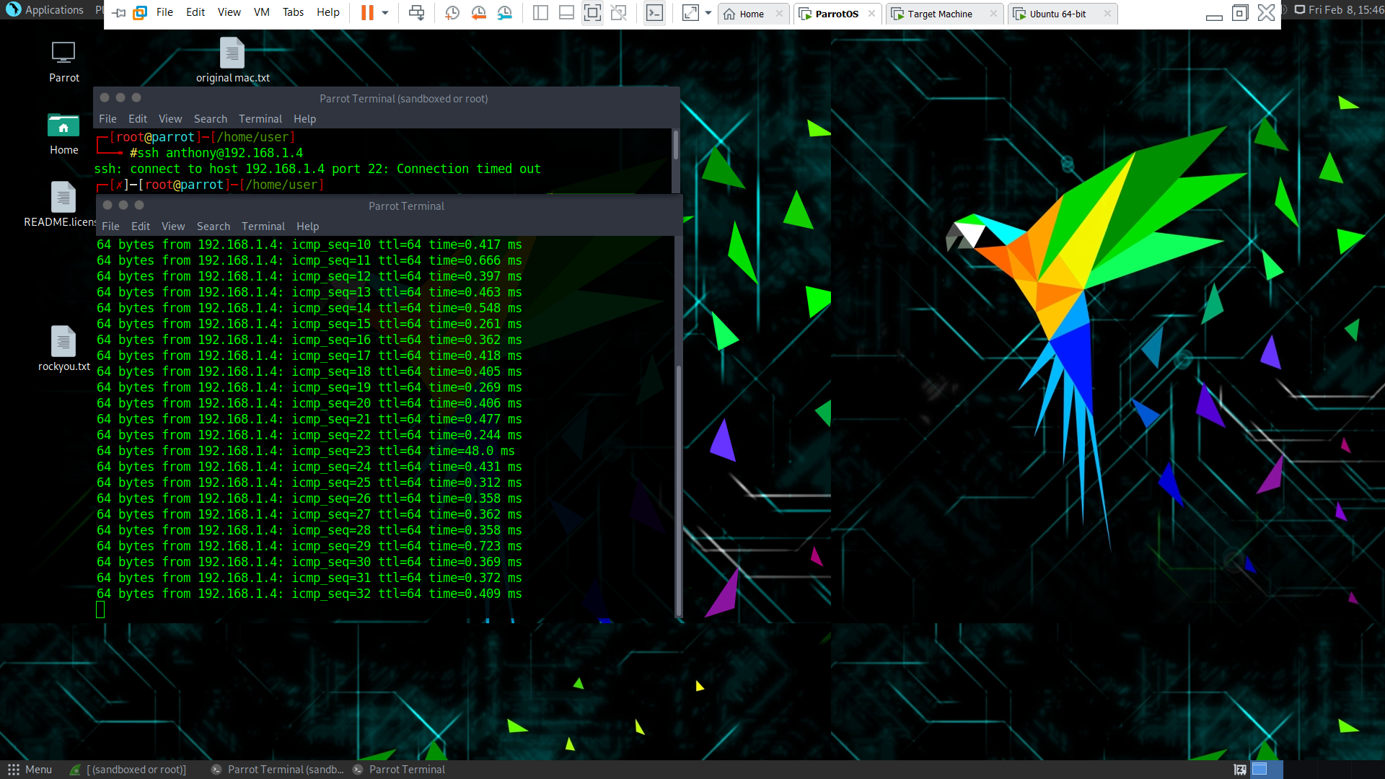
2. SERVICE ATTACK & MITGATIONS

Slide 6
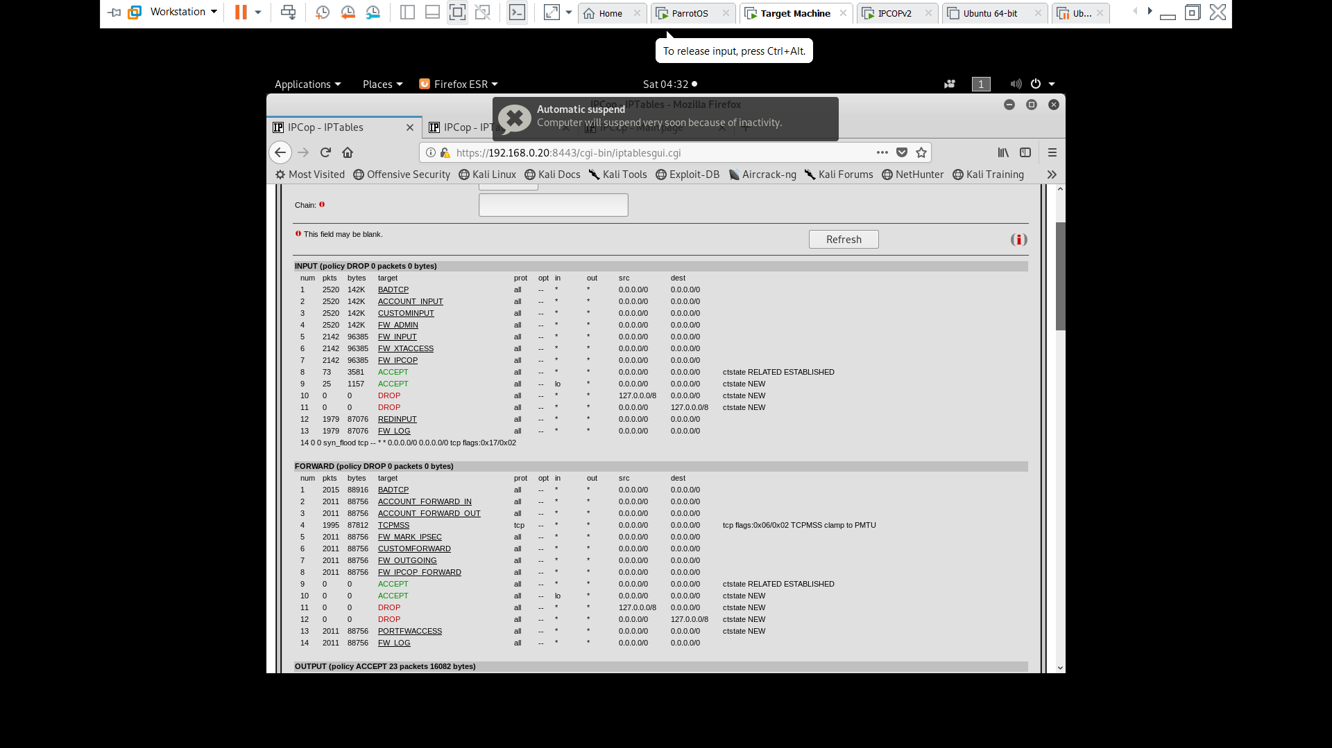
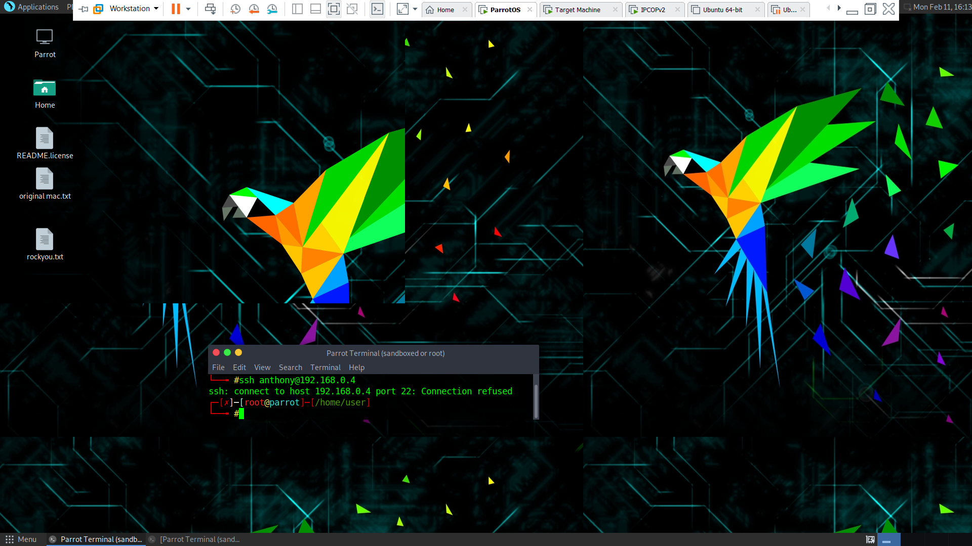
2. SERVICE ATTACK & MITGATIONS

Slide 7
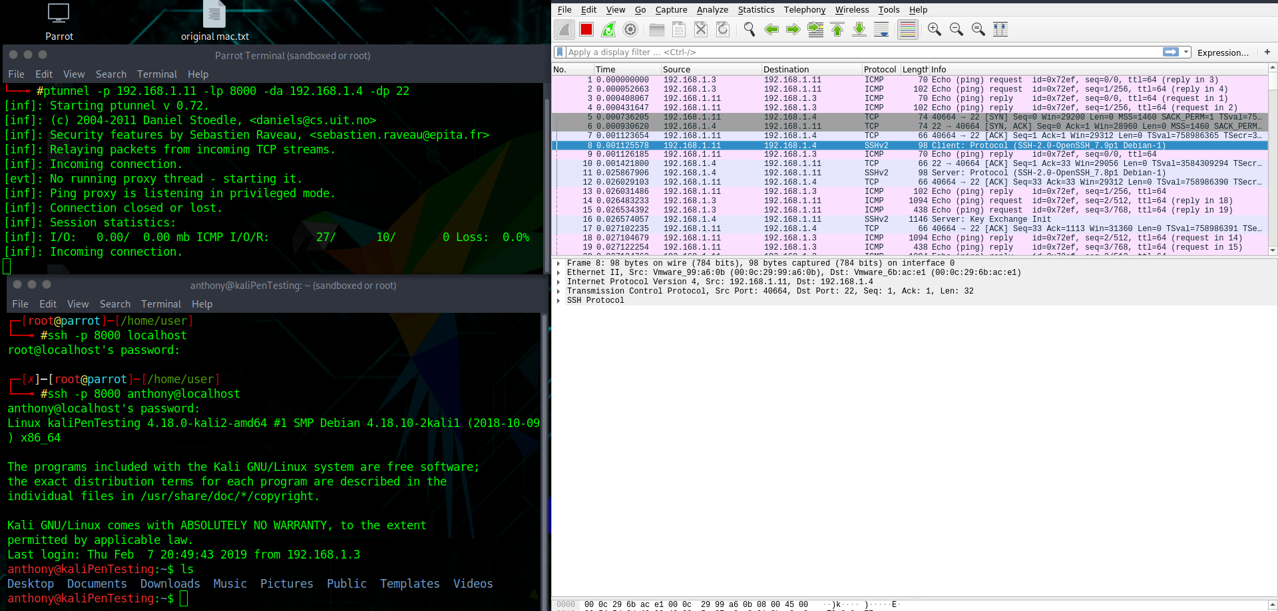
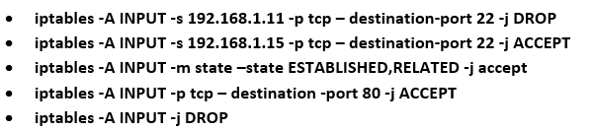
3. PROXY BYPASSES OF MITIGATION & FURTHER MITIGATION

Slide 8
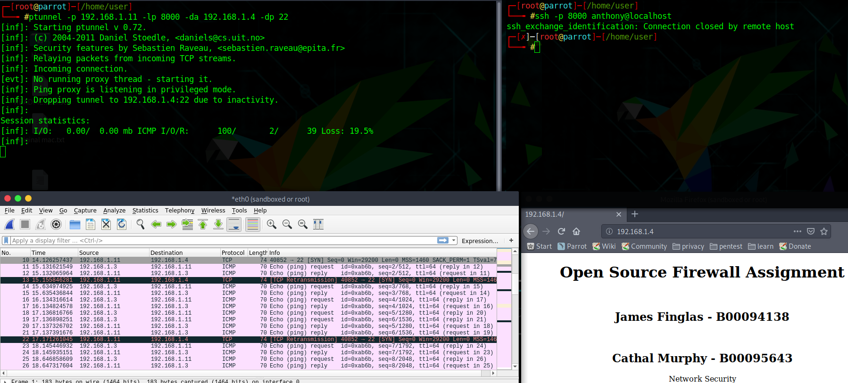
3. PROXY BYPASSES OF MITIGATION & FURTHER MITIGATION

Slide 9
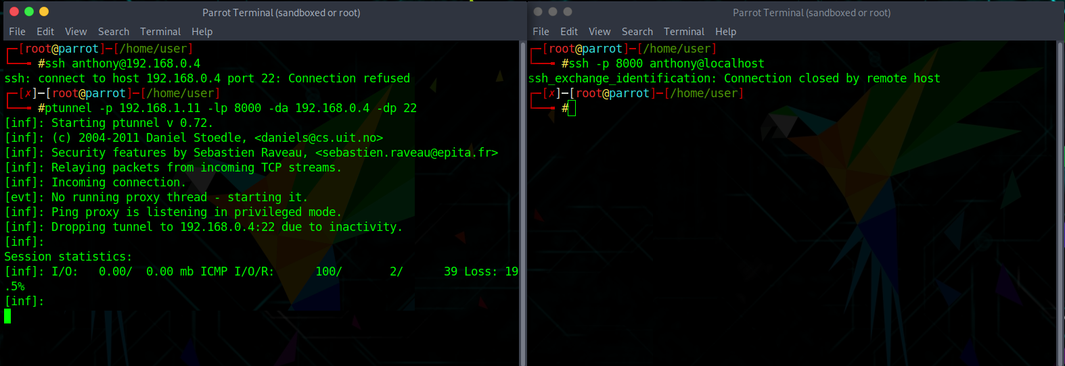
3. PROXY BYPASSES OF MITIGATION & FURTHER MITIGATION

Slide 10
4. COMPARISON AND CONCLUSIONS
IPTables
Adopts Allow-All/Block as needed approach
No Rules by Default
No set up required
Difficult Learning Curve
IPCop
Adopts Block-All/Allow as needed approach
Default traffic filtering
Complex set up
Difficult Learning Curve
Conclusions
IPTables is best utilized in single work stations whereas IPCop works better as a layered network manager

